Slide 1

SMART SECURITY ALERT SYSTEM (Using Cisco Packet Tracer)
AMIT KUMAR SAMAL:- 230720100157
JANMEJAY OJHA:-230720100158
Debabrata PATNAYAK:-23020100126
SUSHREE APARAJITA JENA:-230720100176
SWATI SMARANIKA Choudhry:-230720100140
Under the guidance of
Miss ADYASHA SWAIN

Slide 2
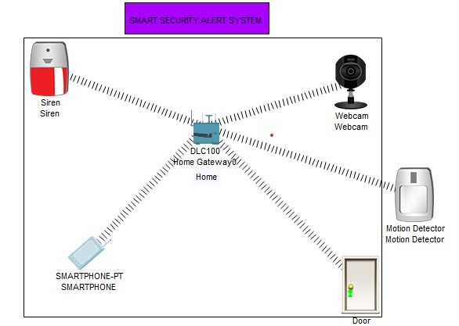
Used Devices For The Design:- Home Gateway – Used to register smart objects & provide smart objects with IP Addresses. Webcam – Capture the view. Motion Detector – Link to your Home Gateway & detect motion. Smart Door – Link to your Home Gateway & provide an event based on functions. Smart Phone – To control the IoT . Siren – To make sound as warning alert.

Slide 3
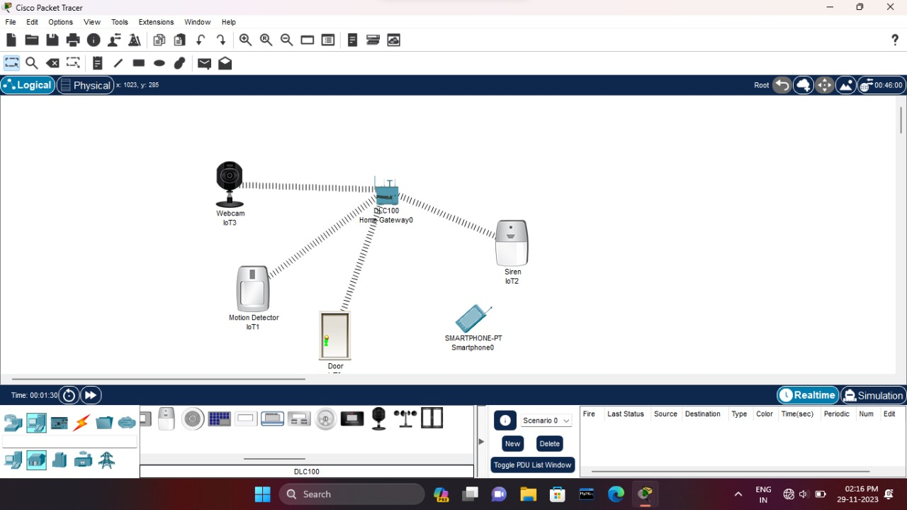
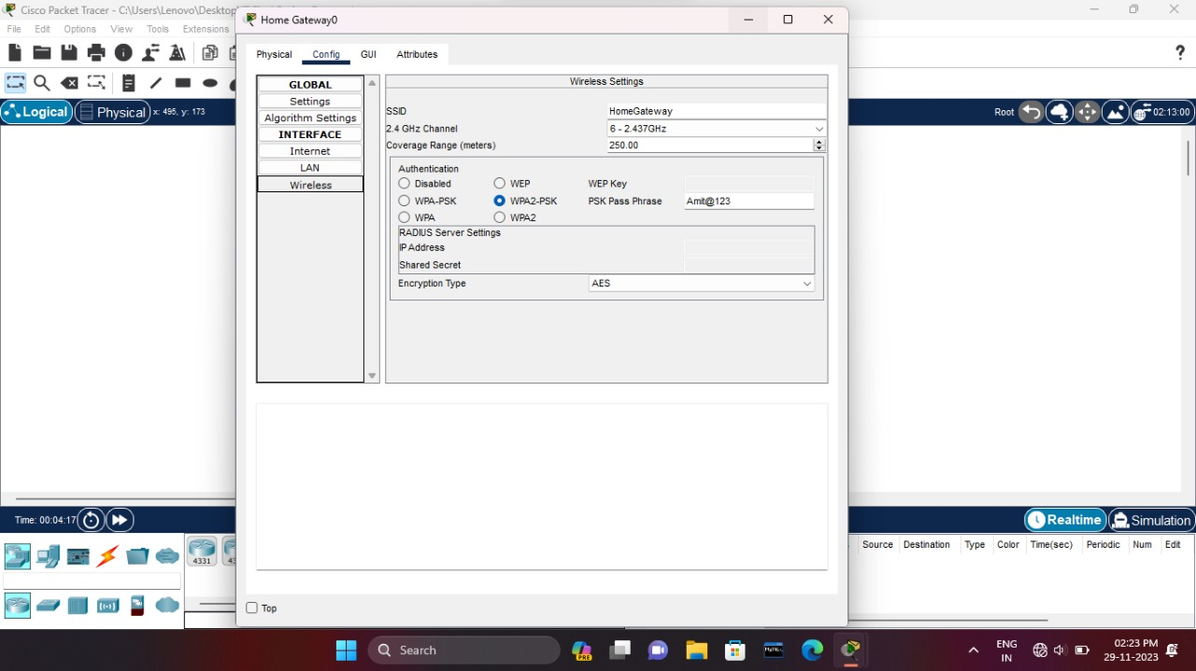
STEP 1:- - Open Cisco Packet Tracer -Drag and drop 1 Home Gateway,1 Siren,1 Motion Detector,1 Door,1 Webcam,1 Smart Phone
STEP 2:-
Now, Home Gateway password created by the configuration of MAC address

Slide 4
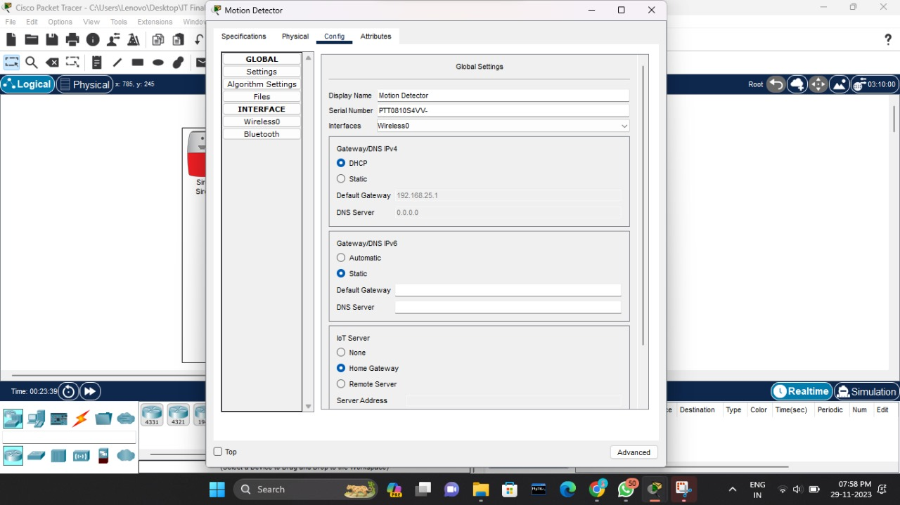
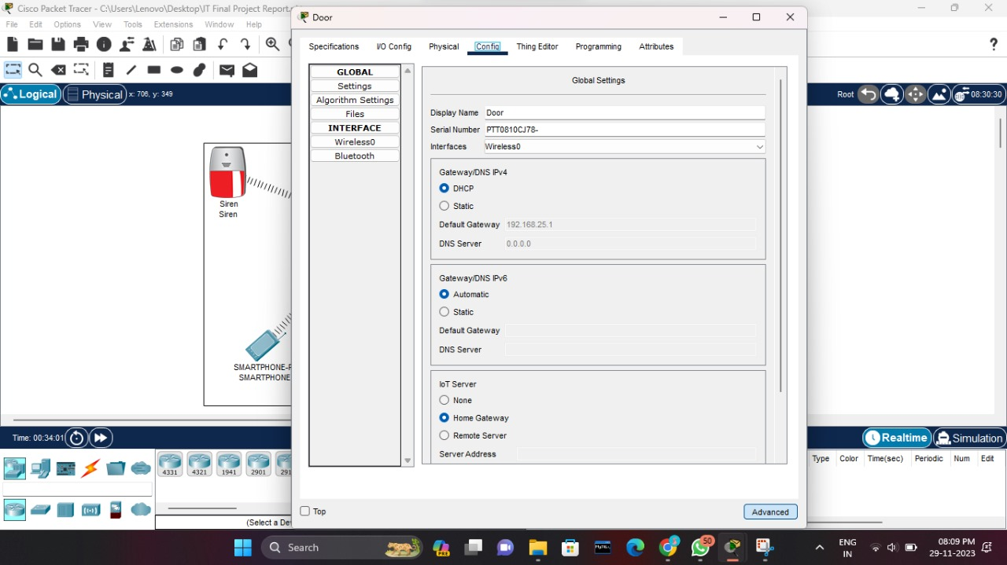
STEP 3:- Now, Motion Detector connected to Home Gateway with serial number,interface default Gateway(192.168.25.1) & the Password.
STEP 4:-
Connect the smart door to Home gateway with wireless configuration & password created.

Slide 5
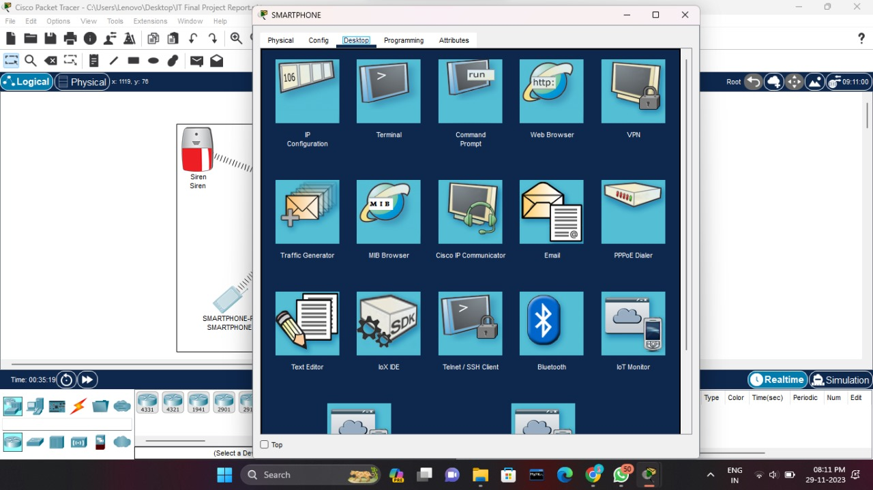
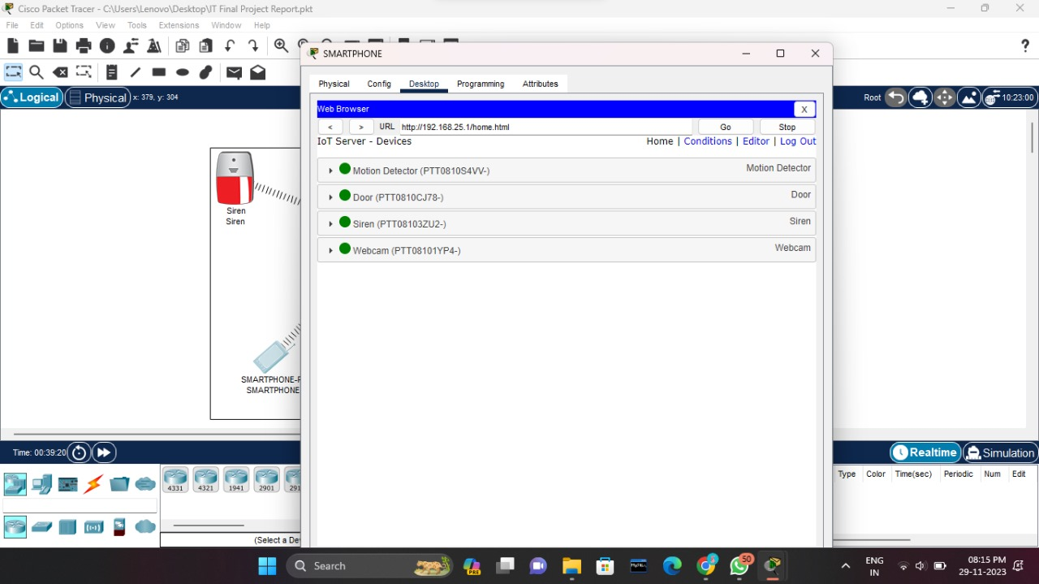
STEP-5:- Connect the smart phone with Home Gateway by URL number .
STEP 6:-
All component connect the smart phone with Home Gateway using wireless network.

Slide 6
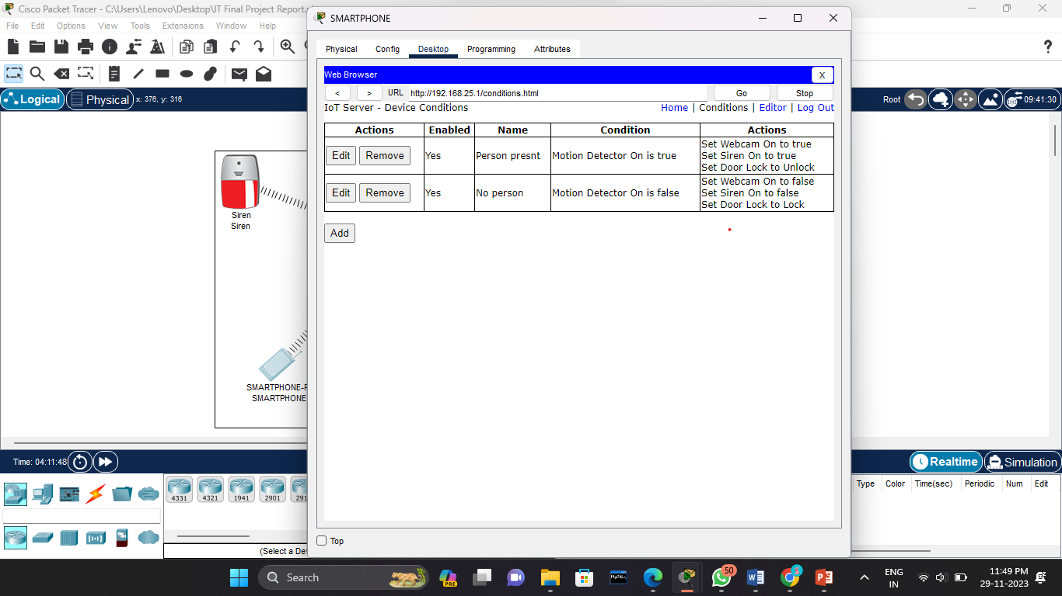
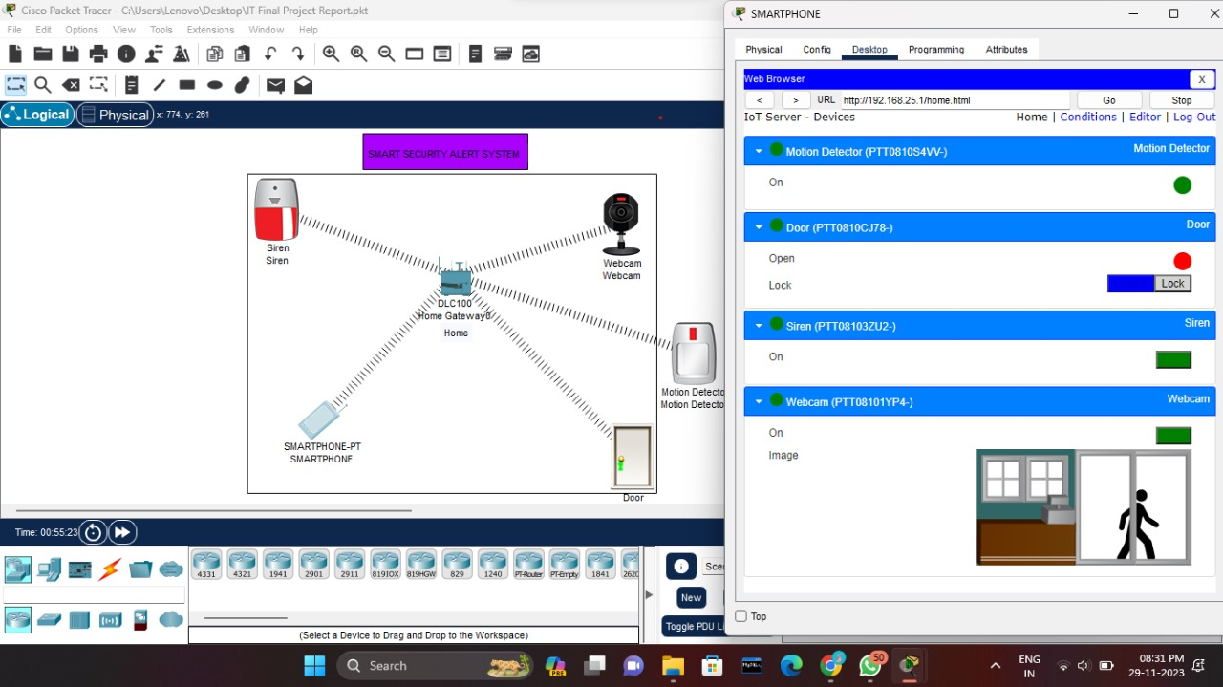
STEP 7:- Now add the conditions such as Condition 1:- When someone is present in the door then the motion detector, webcam & alarm sound is on . Condition 2:- When no one is present in the door then the motion detector, webcam & alarm sound is off.
STEP 8:-
Testing the condition as follows.

Slide 7


